Slide 1
I-69 Ohio river crossing
Selecting a preferred alternative
Marshall carrier, KYTC, Project manager
Dan Prevost, parsons, environmental lead
Tim foreman, kytc, environmental project manager
Notes:
Introductions

Slide 2
Project
overview
Notes:
Kentucky and Indiana are committed to improving the I-69 corridor by creating an I-69 Ohio River Crossing between Evansville and Henderson.
Work started in earnest in early 2017 and we’re reaching a very important milestone.
A preferred alternative is expected this fall and a Draft Environmental Impact Statement (DEIS) published.
We’re going to talk more today about the history of the project (this has been a long time coming), the screening process and how it’s helping us identify a preferred alternative and the many environmental considerations and the coordination needed for a project of this scale.

Slide 3
I-69 ORX: A Missing Link
Will connect Evansville, IN and Henderson, KY
I-69 ORX is one of the last segments needed to complete I-69 in Indiana and Kentucky
Both states have made major investments in the I-69 corridor
Recent improvements extend from
Mayfield, KY to Martinsville, IN
Notes:
This picture helps to sum up why this project is being done.
There is a missing piece and it’s vital – it’s that I-69 cross-river connection between Evansville and Henderson.
Both states have spent a lot of time, money and effort to improve the I-69 corridor.
Those improvements extend along the I-69 corridor from Mayfield, KY to Martinsville, IN…but we have a gap…and this is it.

Slide 4
Project History
2001 Notice of Intent
2004 Draft Environmental Impact Statement (DEIS)
Conducted early in KY and IN’s plans to expand I-69
Purpose and Need
National I-69 Section of Independent Utility #4
Sufficient cross-river mobility in region
Strengthen the regional transportation network
Notes:
This project, like so many, has been years in the making.
There was a Notice of Intent in 2001 and a first Draft Environmental Impact Statement (DEIS) in 2004.
At that point, it was very early in the both Kentucky and Indiana’s plan to expand I-69. Not nearly as much work had been done.
Discuss 2004 Purpose and Need

Slide 5
2004 DEIS
Key Issues
Angel Mounds (visual and noise)
Residential/business relocations
Traffic performance
Floodplains
Funding
Preferred alternative was not financially feasible
With no funding, the project stalled with no Record of Decision
Notes:
There were some key issues identified – Angel Mounds, which we’ve been able to avoid this time, residential and business relocations (which are still a big concern with two of our alternatives), traffic performance and floodplains.
Probably the biggest issue was money. The money wasn’t there. They couldn’t answer how we were going to pay for it.
With no funding identified, the project stalled with no Record of Decision.

Slide 6
10 Years Later
2014 KYTC Feasibility Study
Limited to KY side of the Ohio River
Evaluate potential for single river crossing in the region
Conceptual level only
No recommendation
Key Issues
Relocations in Henderson
Accessibility in US 41 corridor
Notes:
10 years later, Kentucky did its own Feasibility Study (discuss)

Slide 7
A Second Chance
Memorandum of Understanding signed in 2016, directing both states to develop this Environmental Impact Statement
What Has Changed Since 2004
IN and KY have improved more than 260 miles to interstate standards
New crossing is the final connection
Focus on financial feasibility
Tolling is a necessary part of the funding solution
Notes:
This is important to talk about. This really is a second chance for the project.
It was summer of 2016 when Kentucky Gov. Matt Bevin and then-Indiana Gov. Mike Pence signed a memorandum of understanding directing both states to develop this Environmental Impact Statement.
What has changed? A lot. There’s been a tremendous amount of investment along the I-69 corridor. We can’t afford not to complete this connection.
Since 2004, Kentucky and Indiana have spent a lot of money and time to build or improve 260 miles of roadway to interstate standards.
This is a smaller, more focused study area with logical termini.
We’re approaching it with a right-sized, practical design mentality.
KY (and Indiana) have more experience with Alternative Project Delivery tools.
There’s a focus on financial feasibility throughout the process. Let’s make sure we can afford it.
What else has changed? Tolling is a part of the conversation. It’s part of the funding solution. We’ll talk more about that in just a few minutes.

Slide 8
Purpose and Need
Complete the I-69 connection between Indiana and Kentucky
Develop a solution to address
long-term cross-river mobility
Provide a cross-river connection to reduce congestion and delay
Improve safety for cross-river traffic
Notes:
Let’s look at the Purpose and Need for this project. It’s important to complete this missing piece and complete the I-69 connection between Indiana and Kentucky. An I-69 Ohio River Crossing will address long-term cross-river mobility, reduce congestion and improve safety
Any alternative we select must meet all these criteria:
It must complete the I-69 connection between the states.
It must address the long-term needs of the area. The northbound bridge opened in 1932 and the southbound bridge opened in 1965. Maintaining these bridges is progressively becoming more expensive, so the new I-69 Ohio River Crossing must address current traffic demands and demands in the future.
The alternative must reduce congestion and delays. This includes meeting today’s needs and the traffic needs up to 2045.
It must address safety issues in the corridor.
Based on engineering analyses, West Alternative 1, West Alternative 2 and Central Alternative 1 provide the best opportunity to be financially feasible and address the purpose and need of the project. Each alternative is expected to require a combination of toll-backed financing, traditional funds and grant opportunities to move to construction.

Slide 9
Project Timeline
Spring 2017
Work started in earnest
Five broad corridors identified
Summer 2017
Short list of corridors identified
January 2018
Preliminary alternatives developed
Fall 2018
Preferred alternative to be identified
DEIS published
Fall 2019
Final Environmental Impact Statement and Record of Decision expected
Notes:
Our work started in earnest in spring 2017 and we identified five broad corridors.
That summer, will rwe identified a short list of three corridors.
This past January, we had developed three preliminary alternatives from those corridors.
The DEIS this fall will include our preferred alternative. We will hold public hearings in both Henderson and Evansville to allow the public to comment on the preferred alternative.
Between this fall and fall 2019, we will address all the feedback we receive on the DEIS.
We hope to have a Final Environmental Impact Statement and a Record of Decision (ROD) from the Federal Highway Administration in fall 2019. As you know, The ROD allows the states, with the help of available federal funds, to move forward with design, land purchases and construction.

Slide 10
Stay Informed
Website
www.I69ohiorivercrossing.com
Facebook
I-69 Ohio River Crossing
Twitter
@I69ORX
Notes:
As we moved toward that preferred alternative, there are many ways to stay in touch with this project. We have project offices in both Henderson and Evansville.
You can visit our project website. You’ll find a lot of information there, i69ohiorivercrossing.com.
If you’re a social media person, like us on Facebook, I-69 Ohio River Crossing and follow us on Twitter, @I69ORX.
I’m going to turn things over to Dan to tell us more about what the three preliminary alternatives look like and how they were developed.

Slide 11
Alternatives
development

Slide 12
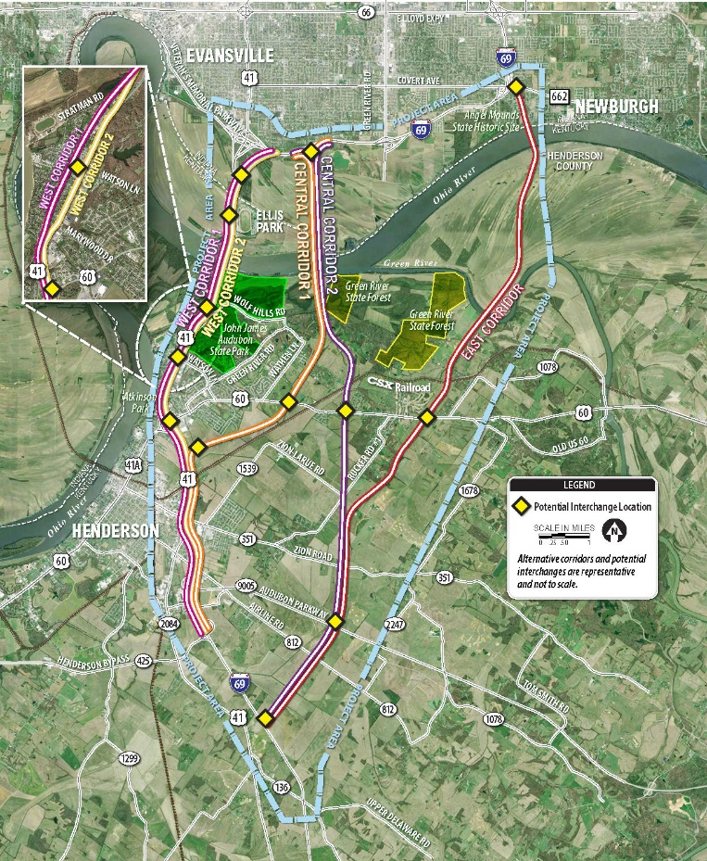
Broad Corridors (presented April 2017)
No Build Alternative
West Corridor 1
West Corridor 2
Central Corridor 1
Central Corridor 2 (2004 DEIS Preferred Alternative)
East Corridor
Notes:
These are the five broad corridors the Project Team identified when we gathered in April.
In addition to the 5 broad corridors you’ve seen – two in the west, two central corridors and one in the east, there is a No Build option.
As required by law, this No Build Alternative is carried forward for comparison. It assumes an I-69 Ohio River Crossing will not be built, and provides a benchmark against which the impacts of other corridors can be compared.
You’ve likely seen the corridors moving forward – West Corridor 1 and West Corridor 2 and Central Corridor 1. Dan will tell us why.
When you talk about the West Corridors, you’re talking about replacing the existing US 41 bridges – which leads to the lowest maintenance costs for the states. But both would impact many homes and businesses in Henderson. We’re going to talk about this.
Central Corridor 1 is the shortest corridor, with the lowest estimated construction costs. – but that cost estimate does not include a solution for the US 41 bridges. It will have to – one bridge, two bridges, no bridges. Can you remove truck traffic to extend the life?

Slide 13
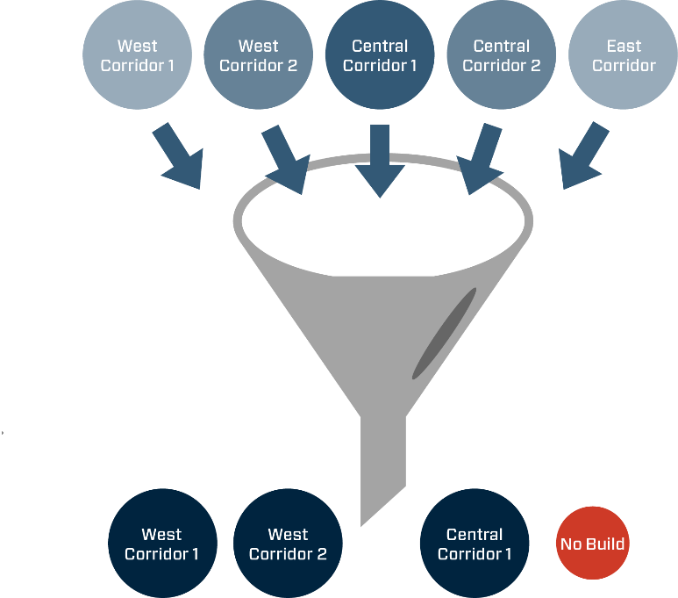
Screening Approach
Develop screening criteria
Conduct “windshield” surveys
Collect additional data
Evaluate Corridors
Does it meet the Purpose and Need?
What are impacts to homes, businesses and the natural environment?
Can we build it and, if so, how much might it cost?

Slide 14
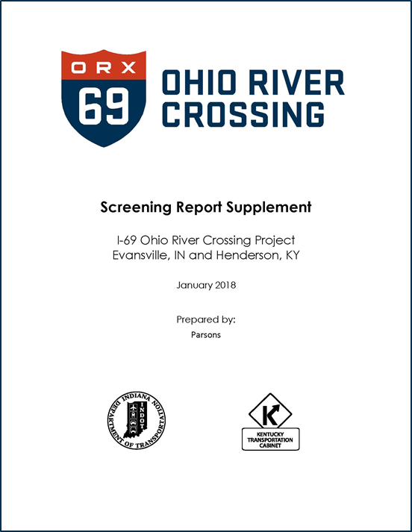
Alternatives Development and Supplemental Screening
Identify and evaluate interchanges (access, traffic performance, safety)
Minimize or avoid impacts to sensitive resources
Consider US 41 corridor accessibility and visibility
Adjust cost estimates to year of expenditure
Estimate life-cycle maintenance costs for I-69 and US 41 bridges
Use traffic models to evaluate bridge and toll scenarios

Slide 15
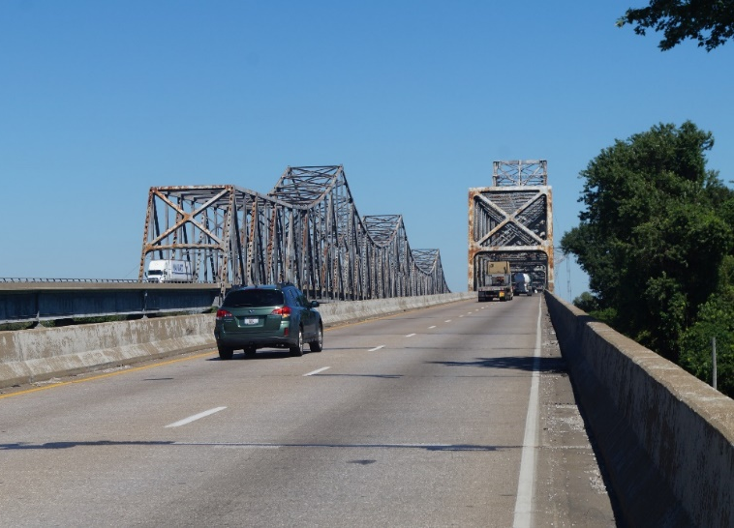
Preliminary Alternatives
For each corridor, 3 bridge scenarios were considered:
Build a 6-lane I-69 bridge for all cross-river traffic and remove both US 41 bridges
Build a 4-lane I-69 bridge and retain one US 41 bridge for local traffic
Build a 4-lane I-69 bridge and retain both US 41 bridges for local traffic
Based on this approach, 10 bridge scenarios were screened

Slide 16
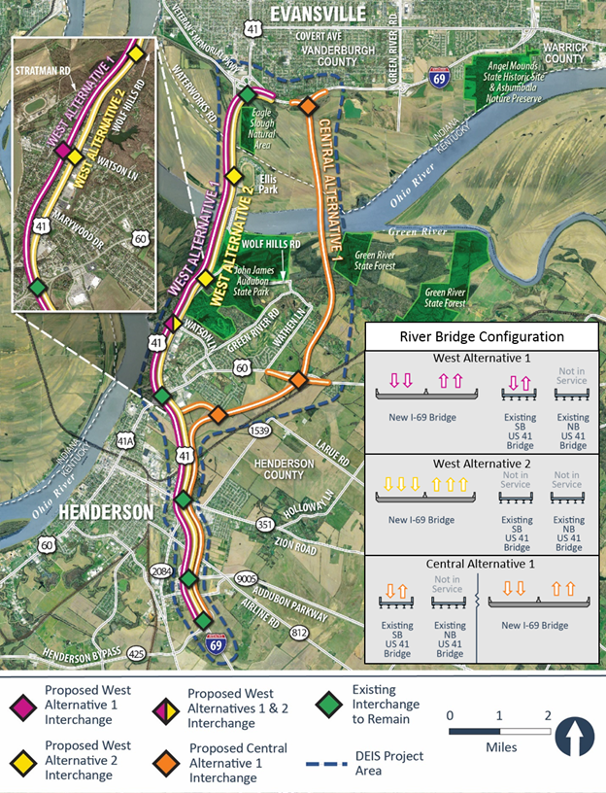
Preliminary Alternatives January 2018
West Alternative 1: 4-lane I-69 bridge and one US 41 bridge for local traffic
West Alternative 2: 6-lane I-69 bridge with both US 41 bridges removed from service
Central Alternative 1: 4-lane I-69 bridge and one US 41 bridge for local traffic
No Build Alternative: Required to serve as baseline for comparison
Other alternatives could be considered based on further analysis
Pending updated graphic

Slide 17
Updated Cost Estimates May 2018
 | No Build | West Alternative 1 | West Alternative 2 | Central Alternative 1
Design, approvals, right of way, mitigation, procurement, construction inspection | $17 M | $312 M | $352 M | $200 M
Construction cost (roadway, bridge, toll system, utilities)
Construction (2017$) | $0 | $879 M | $874 M | $807 M
Construction inflation | $0 | $367 M | $347 M | $255 M
Subtotal - construction | $0 | $1,245 M | $1,221 M | $1,062 M
Roadway and bridge operations and maintenance (35 years) | $270 M | $252 M | $107 M | $234 M
Total | $287 million | $1.81 billion | $1.68 billion | $1.497 billion

Slide 18
Funding and
role of tolling
Notes:
Tolling is an important part of the conversation, because it’s part of the funding solution.

Slide 19
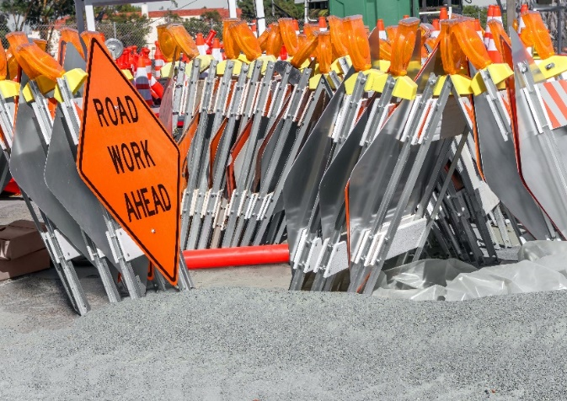
Transportation Funding Challenges
Federal motor fuel taxes fund largest share of IN and KY state transportation construction
Federal gasoline taxes have not increased since 1993
Construction costs +74% since 2003
Motor fuel taxes/mile buys 50% less today than in 1997
Notes:
You can see here why funding is such a challenge for major transportation projects across the country.
The federal gas tax has not increased since 1993
Construction costs have increased significantly, up 74% in the past 15 years
Costs are up with less money available

Slide 20
Paying for I-69 ORX
Requires multiple funding sources:
Traditional federal and state funding
Toll revenues
More than 80% cross-river traffic today is local, forecasted to be 65% in 2045
NEPA must consider consequences and mitigation for possible tolling policies
No scenarios pay for 100% of the project
What we know today:
I-69 will be tolled
With W1 and C1, tolling US 41 may be necessary
Final toll policies determined outside of NEPA, with funding plan before construction
Ohio River Crossings and Regional Through Traffic
20%
35%
41,000 AADT
10% Trucks
50,000 – 55,000 AADT
20% Trucks
80%
65%
Local traffic Through traffic
Notes:
As we mentioned, this project stalled in 2004. One of the reasons the project didn’t move to an FEIS or Record of Decision is funding. How the bridge and interstate connections will be funded must be part of our proposed project if we’re going to get this bridge built.
The estimated project cost will be included in the DEIS. Current estimates range from $1.5 to $1.8 billion.
The states will consider all options to move the project forward. It’s expected to require a combination of toll-backed financing, traditional funds and grant opportunities to move to construction. Recommended solutions will be part of the environmental study process.
Having said that, we know that I-69 will be tolled, regardless of which alternative is selected.
With West Corridor 1 and Central Corridor 1, tolling the existing US 41 bridge is also a possibility.
Our traffic analysis shows that approximately 80 percent of today’s traffic is local. That number is expected to decrease to 65 percent in 2045.
The NEPA study identifies the preferred alternative and proposes mitigation for tolling.
However, the final toll policy and amount won’t be determined in the DEIS or FEIS.
A bi-state body will be created to establish the financing parameters for the project prior to construction. These parameters will include a toll policy, the business rules of what facilities are tolled and what the toll rates are.
The environmental process currently underway will evaluate the potential consequences of tolling scenarios to advise the bi-state body as a financing plan is developed.

Slide 21
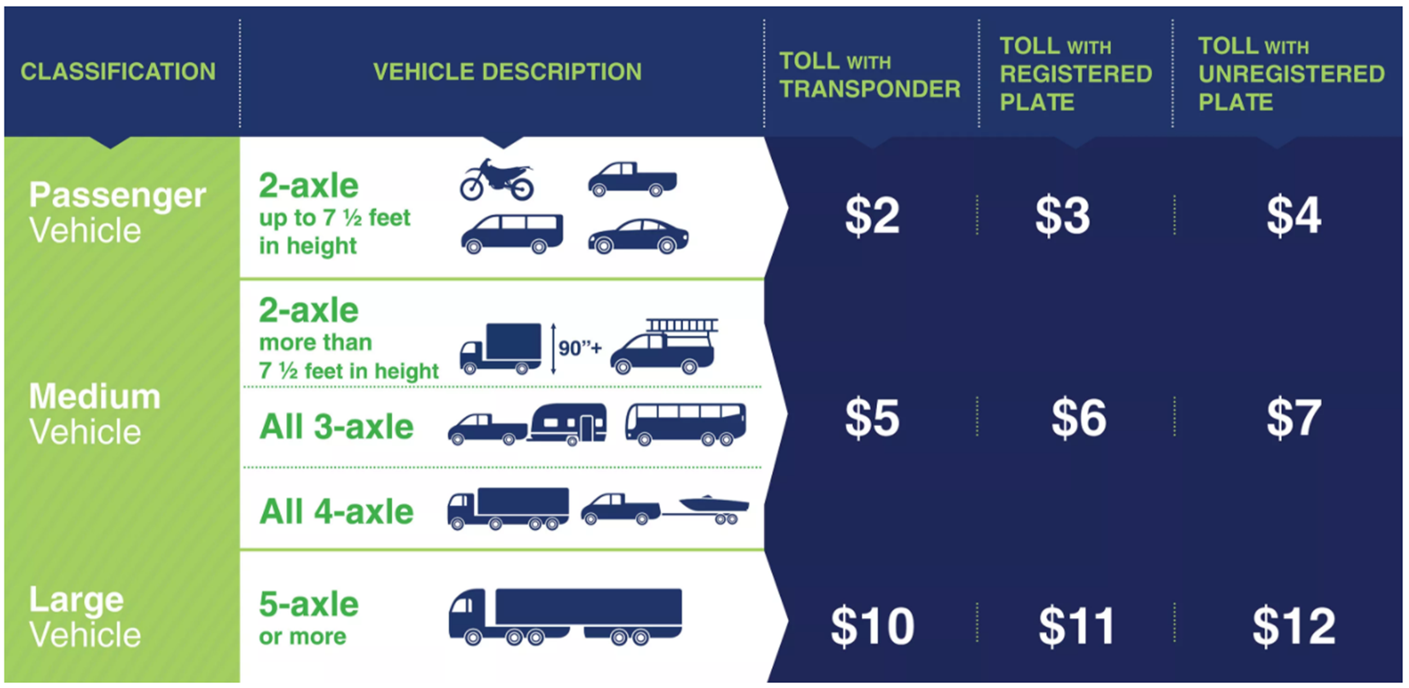
Louisville Toll Rates
Example
Notes:
This Project Team will not determine toll rates. Those decisions will be made by a bi-state body.
However, this team does examine traffic modeling and tolling scenarios to gather information that will be used to develop a financial plan.
The Project Team makes assumptions for those studies. We’re assuming toll rates that would be similar to what were used in Louisville for the Ohio River Bridges Project.
Those tolls are based on vehicle height and classification. You’ll see the lowest rate -- $2 per crossing is for passenger vehicles with a transponder and prepaid account. Without a transponder and account, it’s $2 more per crossing.
Larger vehicles pay higher toll rates. The highest rate is for a 5-axle vehicle (a semi) without a transponder. That rate is $12 per crossing.

Slide 22
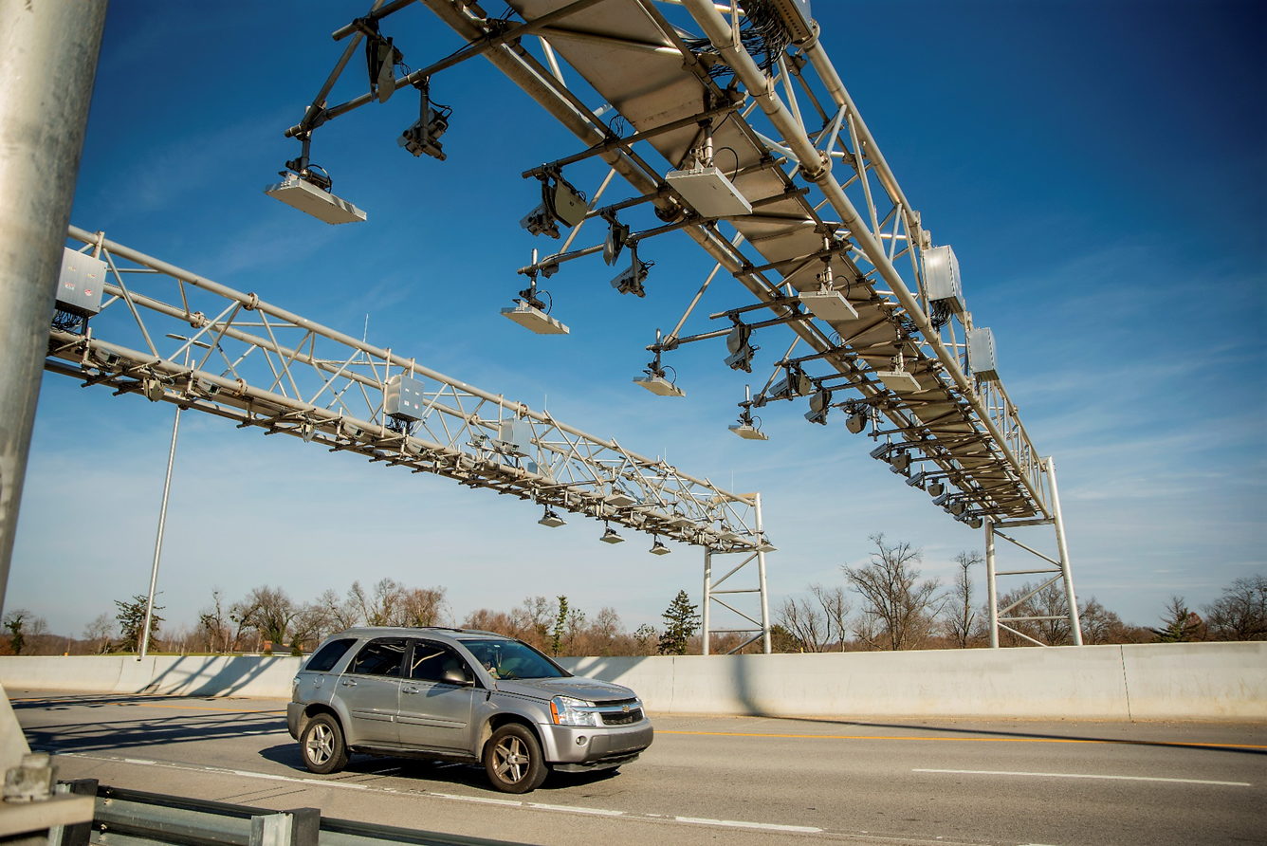
Modern Tolling
Gantry mounted sensors
No stopping, no toll-booths
Notes:
Tolling of today looks very different from the tolling that many of us usually think about – rolling down a window and tossing coins into a bucket.
Tolling on this project would be all-electronic tolling, which means no slowing, no stopping and no lines. Traffic keeps moving.
Sensors are used to read transponders, small devices on the inside of a car’s windshield, and the appropriate toll is deducted from a prepaid account.
For drivers without accounts, cameras capture license plates and invoices are sent to registered owners of the vehicles.
The lowest toll rates are for drivers with transponders and prepaid accounts.

Slide 23
Public outreach
Notes:
Public involvement is an important part of this process…making sure the public is informed and has a chance to share their opinions, concerns and ideas.

Slide 24
RCAC and EJ Committees
River Cities Advisory Committee
Environmental Justice Subcommittee
Diverse group of engaged voices
Meet near project milestones
Sounding board for study information and choices
Facilitate collaborative problem solving, discussion of specific issues
Link to the community, sharing project information
Notes:
We’ve had several opportunities for people to be a part of this project.

Slide 25
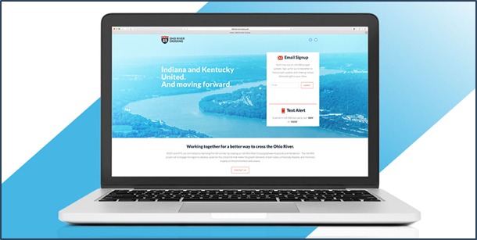
Public Survey
4,668 mailed to residents in EJ block groups
Also available on the “Survey” page on the project website
570 completed surveys
335 via mail, 235 online
463 from Kentucky, 101 from Indiana
75 low-income, 38 minority
35%
Notes:
This spring, we conducted a public survey following our open houses.

Slide 26
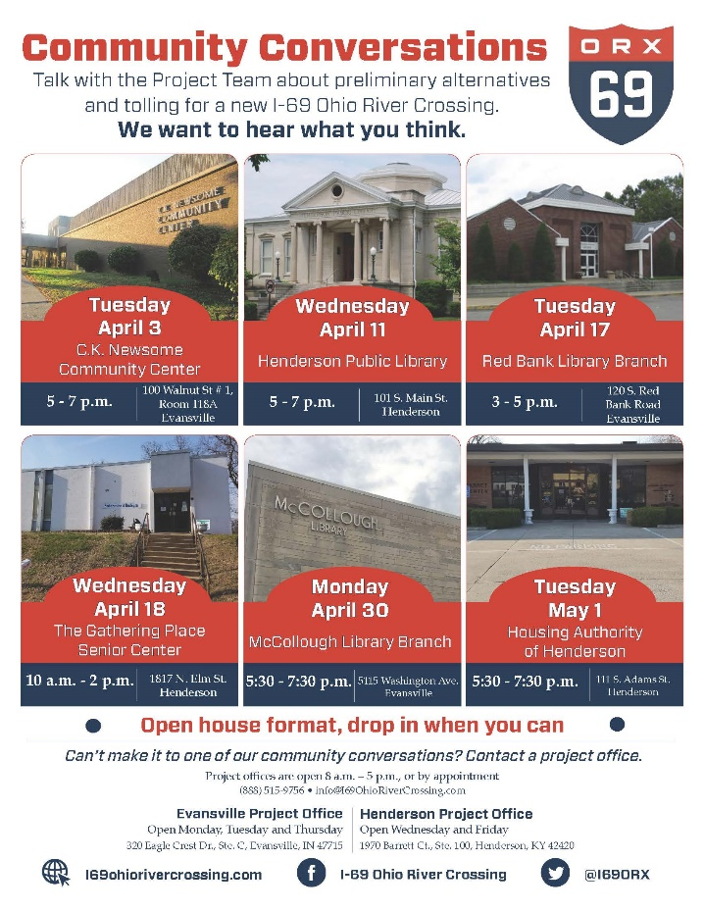
Community
Conversations
Six Community Conversations held early this year
Heavily promoted
6,000 postcards sent to residents in EJ block groups
Fliers sent home with local students
More than 255 people attended
Productive conversations
Important feedback gathered
35%
Notes:
In addition to a series of open houses, we hosted six Community Conversations this spring.
We’re going to wrap up today by talking about Environmental Impacts. I’m going to hand things off to Tim Foreman, KYTC’s environmental project manager.

Slide 27
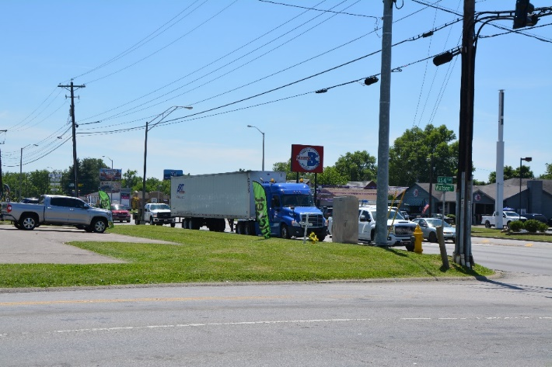
Business Information Survey
910 post cards mailed to businesses within one mile of the center line of the three alternatives, plus all downtown Henderson businesses
Also linked from the “Survey” page on website
In-person visits with 87 businesses
59 complete or nearly complete responses
Average duration at location is 32 years
About half depend on walk-up or drive-by traffic
35%
Notes:
We also had a survey to collect business information

Slide 28
Environmental
impacts

Slide 29
Environmental Impacts
Socioeconomic impacts vs. natural environment impacts
Dramatic differences between West Alternative 1/West Alternative 2 and Central Alternative 1
West 1 and West 2 follow or are adjacent to US 41, a highly-developed main thoroughfare
Central 1 is largely green space and farmland
Notes:
This is important to talk about.
For those in the room who weren’t around 13 years ago, weren’t paying attention, or simply forgot – this really is a second chance.
We have been there before. We were at this point, with IN working on a Draft Environmental Impact Statement.
In fact, that draft was complete in 2004 and a preferred alternative selected, but they never made it to a Final Environmental Impact Statement and a Record of Decision.
Why? The money wasn’t there. They couldn’t answer how we were going to pay for it.
What has changed? A lot. There’s been a tremendous amount of investment along the I-69 corridor. We can’t afford not to complete this connection.
There’s a focus on financial feasibility throughout the process. Let’s make sure we can afford it.
What else has changed? Tolling is a part of the conversation. We’ll talk more about that in just a few minutes.
When you have a financially feasible project with a plan for how to pay for it – that’s what will get this bridge built.

Slide 30
Natural Environment
West 1 and West 2
Fewest impacts to rivers/streams, floodplains, prime and active farmland
Low impacts to forested habitat
Central 1
Highest impact to forested wetlands and forested habitat
Highest impact to active farmland
Notes:
This is important to talk about.
For those in the room who weren’t around 13 years ago, weren’t paying attention, or simply forgot – this really is a second chance.
We have been there before. We were at this point, with IN working on a Draft Environmental Impact Statement.
In fact, that draft was complete in 2004 and a preferred alternative selected, but they never made it to a Final Environmental Impact Statement and a Record of Decision.
Why? The money wasn’t there. They couldn’t answer how we were going to pay for it.
What has changed? A lot. There’s been a tremendous amount of investment along the I-69 corridor. We can’t afford not to complete this connection.
There’s a focus on financial feasibility throughout the process. Let’s make sure we can afford it.
What else has changed? Tolling is a part of the conversation. We’ll talk more about that in just a few minutes.
When you have a financially feasible project with a plan for how to pay for it – that’s what will get this bridge built.

Slide 31
Relocation Estimates May 2018
West Alternative 1
West Alternative 2
242 Residences
27 Businesses
96 Residences
64 Businesses
Central Alternative 1
4 Residences
0 Businesses
February 2018 Estimates
 | Residences | Businesses
West Alternative 1 | 213 | 21
West Alternative 2 | 119 | 58
Central Alternative 1 | 2 | 0

Slide 32
Environmental Justice
Identifying and addressing disproportionately high and adverse effects on low-income or minority populations
Many conversations centered on effect of tolling on EJ populations
A variety of tolling scenarios being considered
Tolling is necessary to help move the project to construction
Notes:
This is important to talk about.
For those in the room who weren’t around 13 years ago, weren’t paying attention, or simply forgot – this really is a second chance.
We have been there before. We were at this point, with IN working on a Draft Environmental Impact Statement.
In fact, that draft was complete in 2004 and a preferred alternative selected, but they never made it to a Final Environmental Impact Statement and a Record of Decision.
Why? The money wasn’t there. They couldn’t answer how we were going to pay for it.
What has changed? A lot. There’s been a tremendous amount of investment along the I-69 corridor. We can’t afford not to complete this connection.
There’s a focus on financial feasibility throughout the process. Let’s make sure we can afford it.
What else has changed? Tolling is a part of the conversation. We’ll talk more about that in just a few minutes.
When you have a financially feasible project with a plan for how to pay for it – that’s what will get this bridge built.

Slide 33
Agency
coordination
Notes:
Public involvement is an important part of this process…making sure the public is informed and has a chance to share their opinions, concerns and ideas.

Slide 34
Section 106
Consider effects of project on historic properties
Avoid, minimize and mitigate
Consulting parties engaged throughout the process
Coordination with Kentucky Heritage Council (KHC)
Central Alternative 1 alignment was shifted to avoid historic properties at US 60
Notes:
This is important to talk about.
For those in the room who weren’t around 13 years ago, weren’t paying attention, or simply forgot – this really is a second chance.
We have been there before. We were at this point, with IN working on a Draft Environmental Impact Statement.
In fact, that draft was complete in 2004 and a preferred alternative selected, but they never made it to a Final Environmental Impact Statement and a Record of Decision.
Why? The money wasn’t there. They couldn’t answer how we were going to pay for it.
What has changed? A lot. There’s been a tremendous amount of investment along the I-69 corridor. We can’t afford not to complete this connection.
There’s a focus on financial feasibility throughout the process. Let’s make sure we can afford it.
What else has changed? Tolling is a part of the conversation. We’ll talk more about that in just a few minutes.
When you have a financially feasible project with a plan for how to pay for it – that’s what will get this bridge built.

Slide 35
Interagency Cooperation
Coordination with federal, state and local agencies
Multi-jurisdictional coordination
Interagency Advisory Committee
Regular meetings and field tour
Includes formal consultation with US Fish & Wildlife for early discussion of approach to survey work, mussels and bats
Notes:
This is important to talk about.
For those in the room who weren’t around 13 years ago, weren’t paying attention, or simply forgot – this really is a second chance.
We have been there before. We were at this point, with IN working on a Draft Environmental Impact Statement.
In fact, that draft was complete in 2004 and a preferred alternative selected, but they never made it to a Final Environmental Impact Statement and a Record of Decision.
Why? The money wasn’t there. They couldn’t answer how we were going to pay for it.
What has changed? A lot. There’s been a tremendous amount of investment along the I-69 corridor. We can’t afford not to complete this connection.
There’s a focus on financial feasibility throughout the process. Let’s make sure we can afford it.
What else has changed? Tolling is a part of the conversation. We’ll talk more about that in just a few minutes.
When you have a financially feasible project with a plan for how to pay for it – that’s what will get this bridge built.

Slide 36
Creative mitigation
options
Notes:
Public involvement is an important part of this process…making sure the public is informed and has a chance to share their opinions, concerns and ideas.

Slide 37
Green River National Wildlife Refuge
Long-proposed wildlife refuge along the Ohio River in Henderson
Halted for years by lack of funds for land acquisition
Approximately 24,000 acres
Supporters believe I-69 ORX could mean new life for proposed refuge
Opportunity for creative, project-area mitigation options
Notes:
This is important to talk about.
For those in the room who weren’t around 13 years ago, weren’t paying attention, or simply forgot – this really is a second chance.
We have been there before. We were at this point, with IN working on a Draft Environmental Impact Statement.
In fact, that draft was complete in 2004 and a preferred alternative selected, but they never made it to a Final Environmental Impact Statement and a Record of Decision.
Why? The money wasn’t there. They couldn’t answer how we were going to pay for it.
What has changed? A lot. There’s been a tremendous amount of investment along the I-69 corridor. We can’t afford not to complete this connection.
There’s a focus on financial feasibility throughout the process. Let’s make sure we can afford it.
What else has changed? Tolling is a part of the conversation. We’ll talk more about that in just a few minutes.
When you have a financially feasible project with a plan for how to pay for it – that’s what will get this bridge built.

Slide 38
THANK YOU

